Slide 1
Angular Routing

Slide 2
→As users perform application tasks, they need to move between the different views that you have defined.
→The following command uses the Angular CLI to generate a basic Angular app with an app routing module, called AppRoutingModule, which is an NgModule where you can configure your routes.
>ng new routing-app --routing
(or)
ng generate module app-routing --flat --module=app
--flat puts the file in src/app instead of its own folder.
--module=app tells the CLI to register it in the imports array of the AppModule.

Slide 3
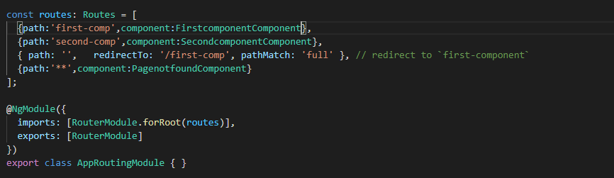
RouterModule.forRoot()
The @NgModule metadata initializes the router and starts it listening for browser location changes.
RouterModule to the AppRoutingModule imports array and configures it with the routes in one step by calling RouterModule.forRoot():

Slide 4
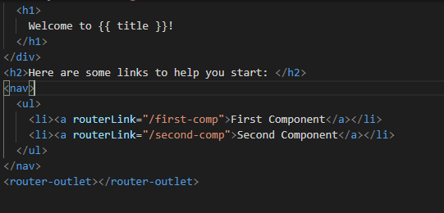
Add RouterOutlet
Open the AppComponent template and place the <router-outlet> element.
src/app/app.component.html (router-outlet)
→The <router-outlet> tells the router where to display routed views.

Slide 5
Displaying a 404 page
To display a 404 page, set up a wildcard route with the component property set to the component you'd like to use for your 404 page as follows:
const routes: Routes = [
{ path: 'first-component', component: FirstComponent },
{ path: 'second-component', component: SecondComponent },
{ path: '**', component: PageNotFoundComponent }, // Wildcard route for a 404 page
];
→The last route with the path of ** is a wildcard route.
→The router selects this route if the requested URL doesn't match any of the paths earlier in the list and sends the user to the PageNotFoundComponent.

Slide 6
Setting up redirects
To set up a redirect, configure a route with the path you want to redirect from, the component you want to redirect to, and a pathMatch value that tells the router how to match the URL.
const routes: Routes = [
{ path: 'first-component', component: FirstComponent },
{ path: 'second-component', component: SecondComponent },
{ path: '', redirectTo: '/first-component', pathMatch: 'full' }, // redirect to `first-component`
{ path: '**', component: PageNotFoundComponent }, // Wildcard route for a 404 page
];

